Slide 1

Project 1 – Data Analytics
Halley Ngoc Pham
Liam Baker
Mark Stephen

Slide 2

Hypothesis
Null Hypothesis:
There was no change in house price trends at the start of COVID-19
Alternative Hypothesis:
There was a change in house price trends at the start of COVID-19
During COVID-19, the benefits of living in an urban area vanished – many businesses moved to remote work, people were unable to make use of the closer facilities, and the regional areas spent much less time in lockdown than urban regions.
It was often reported that this caused many people to move from urban regions to regional ones, so this project investigates house prices to see if there was any change linked to COVID-19
2

Slide 3
Project Description
Research questions to answer
1. What was the effect of Covid19 on the Australian house prices?
2. Did the number of house sales increase due to Covid19?
3. What regional areas showed the biggest increase in % sales price during Covid19?
4. What city areas showed the biggest increase in % sales price during Covid19?
5. What state/states showed the biggest average increase in sales price over the year?
6. What was the average sales price before and after Covid19 per state?
Dataset used - Australian Bureau of Statistics - Residential Property Price Indexes Seven Capital Cities
API used
- Google custom search API
Covid19 impact to Aus. housing price
Cost of dwellings in major cities vs rural areas before & after the Covid19
1
Notes:
The basis of our project is to perform an analysis on the impact of Covid19 on housing sale values around Australia.
In our analysis we look at the cost of dwellings in major cities and rural areas before the beginning of Covid19 and how the impact of Covid19 effected housing prices in cities vs regional areas

Slide 4
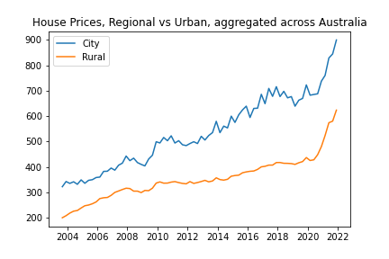
What was the effect of Covid19 on the Australian house prices?
COVID-19 is tied to a sharp increase in house prices across Australia
Rate of house price increase was almost identical between regional and urban from 2020 onwards
Difference of less than 2%, with a 99% confidence interval
This means the percentage increase in house prices was significantly higher for rural areas
3

Slide 5
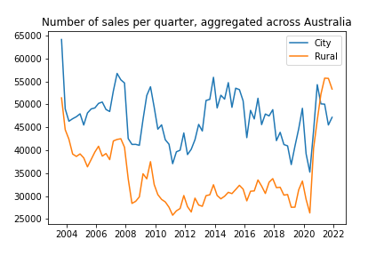
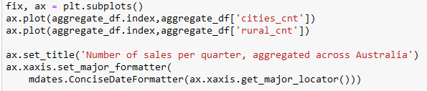
Did COVID19 Affect The Rate Of House Sales?
Large amount of fluctuation in house sales
House sales typically trending downwards pre-2019
After the impact of COVID-19, large spike in rural house sales
4

Slide 6
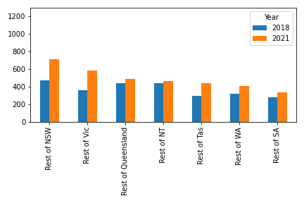
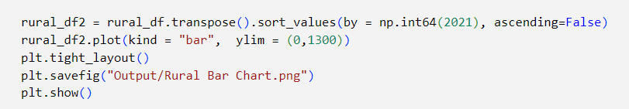
What regional areas showed the biggest increase in sales price during Covid19?
New South Wales, Victoria and Tasmania showed the biggest percentage increases with Tasmania also putting in a strong increase.
This shows that after the onset of Covid19 there was a sharp percentage increase in key regional areas but did not rise as sharply across the rest of the country’s regional areas except for Tasmania.
5

Slide 7
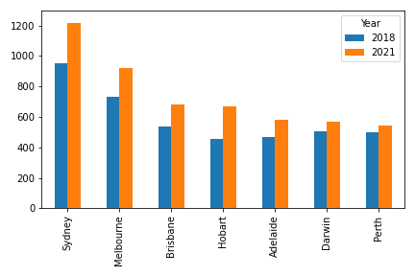
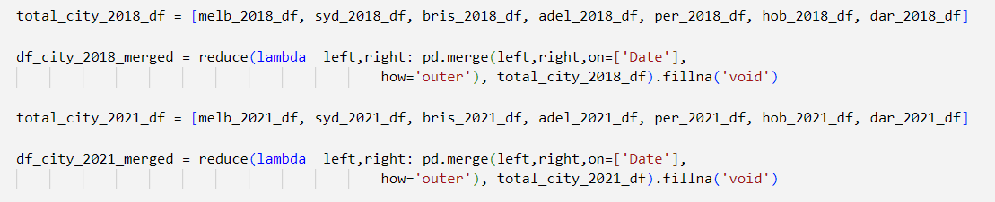
What city areas showed the biggest increase in sales price during Covid19?
In this chart we can see that Sydney, Melbourne and Hobart showed a significant percentage increase from 2018 to 2021.
This shows that after the onset of Covid19 there was a sharp increase in key metro areas but not as sharp across the rest of the country's metro areas.
6

Slide 8
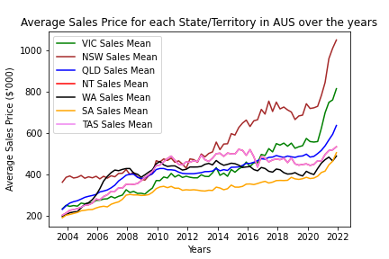
What state/states showed the biggest average increase in sales over the year?
There is a clear difference in house price increase between states
NSW: highest house prices (>$1M)
VIC: ~ $800k
QLD ~$600k
The rest: small increased
7

Slide 9
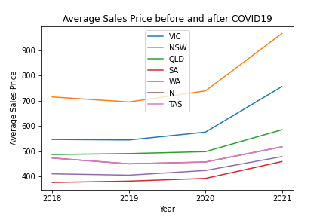
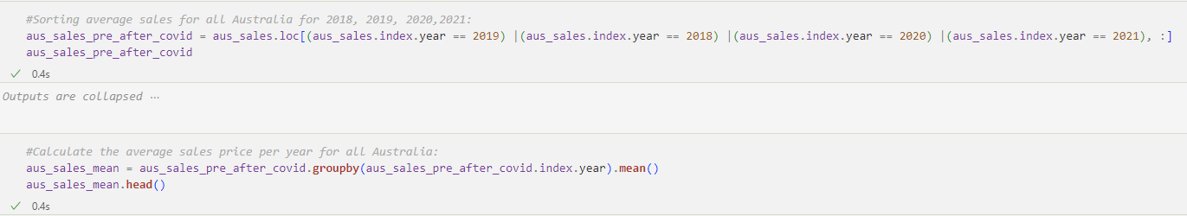
What was the average sales price before and after Covid19 per state?
Before Covid19, small increased
Covid19 Start, no changed much
2020-2021: hike jumped
2020: interest rate: 0.75% -> 0.1%
2021: interest rate: 0.1%
8

Slide 10
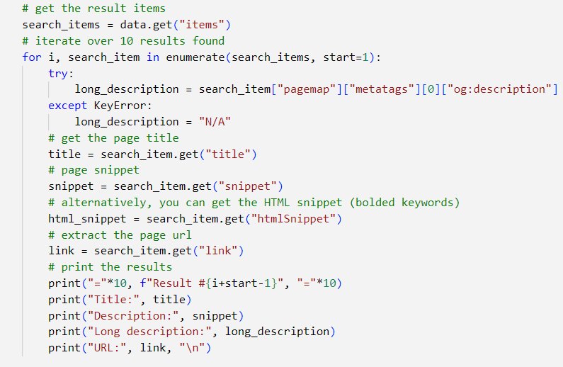
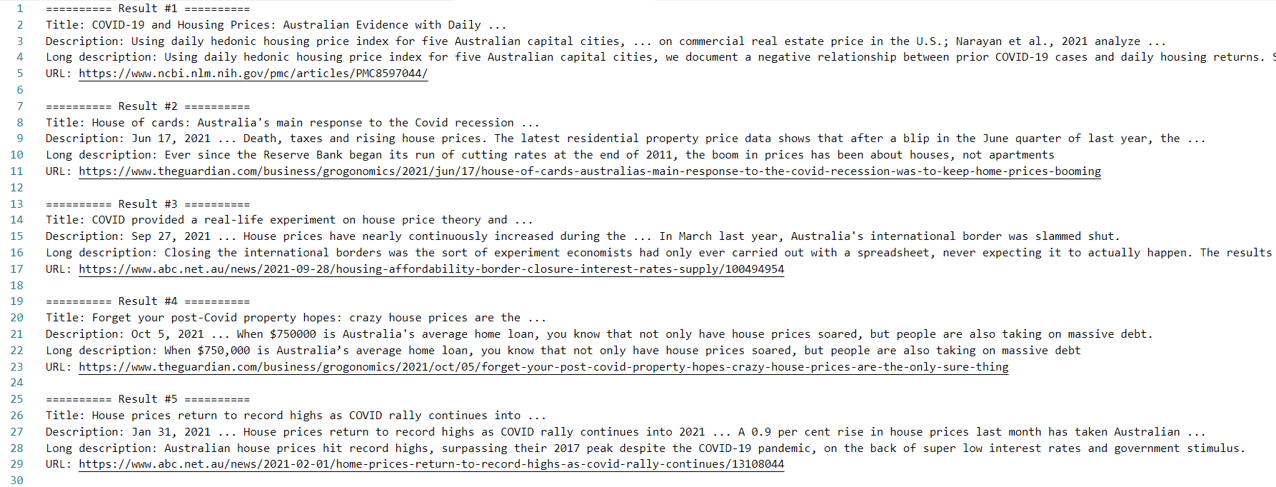
Using Google Search API to check news stories from 2021 to support Hypothesis.
To verify out hypothesis we used Google Search API to check news stories from 2021 with the search term “housing prices Australia covid 2021”.
This returned news articles stating the rapid increase in housing prices due to increased demand from Covid19.
9

Slide 11
Conclusion
Alternative Hypothesis Proven
There was a clear change in price trends before and after COVID-19
But as there was a lot of economic disruption at this time, people moving to rural areas is unlikely to be the sole driver of this change.
1

Slide 12
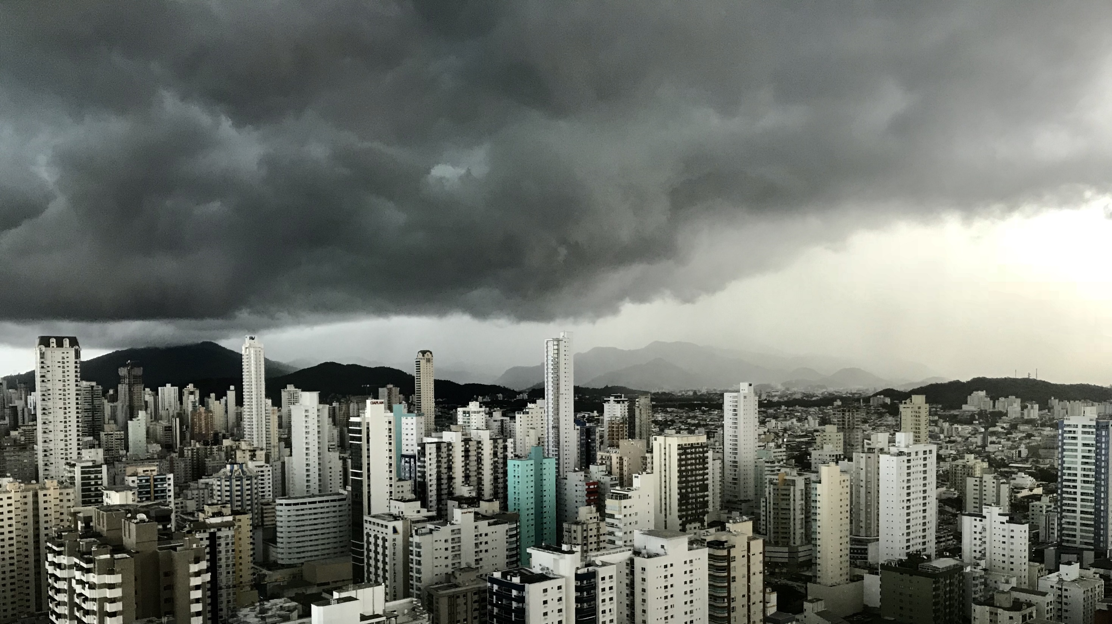
Slide 11
THANK YOU

